Slide 1
Virtual Reality

Slide 2
Outline
Introduction
The history of VR
Types of VR
Technologies of VR
Architecture of VR system
Applications of VR
Current problems & Future work
Summary
Reference

Slide 3
Introduction
What is Virtual Reality(VR)?
Virtual Reality refers to a high-end user interface that involves real-time simulation and interactions through multiple sensorial channels.
.

Slide 4
Introduction (Cont’d)
Why VR?
VR is able to immerse you in a computer-generated world of your own making: a room, a city, the interior of human body. With VR, you can explore any uncharted territory of the human imagination.

Slide 5
Brief History
In 1950s, flight simulators were built by US Air Force to train student pilots.
In 1965, a research program for computer graphics called “The Ultimate Display” was laid out.
In 1988, commercial development of VR began.
In 1991, first commercial entertainment VR system "Virtuality" was released.

Slide 6
Types of VR System
Windows on World(WoW)
  Also called Desktop VR.
  Using a conventional computer monitor to display the 3D virtual world.
Immersive VR
  Completely immerse the user's personal viewpoint inside the virtual 3D world.
  The user has no visual contact with the physical word.
  Often equipped with a Head Mounted Display (HMD).

Slide 7
Types of VR System(Cont’d)
Telepresence
  A variation of visualizing complete computer generated worlds.
  Links remote sensors in the real world with the senses of a human operator. The remote sensors might be located on a robot. Useful for performing operations in dangerous environments.

Slide 8
Types of VR System(Cont’d)
Mixed Reality(Augmented Reality)
  The seamless merging of real space and virtual space.
  Integrate the computer-generated virtual objects into the physical world which become in a sense an equal part of our natural environment.
Distributed VR
  A simulated world runs on several computers which are connected over network and the people are able to interact in real time, sharing the same virtual world.

Slide 9
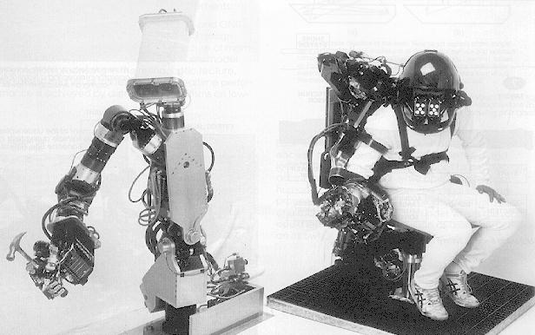
VR Examples (Cont’d)
Telepresence VR

Slide 10
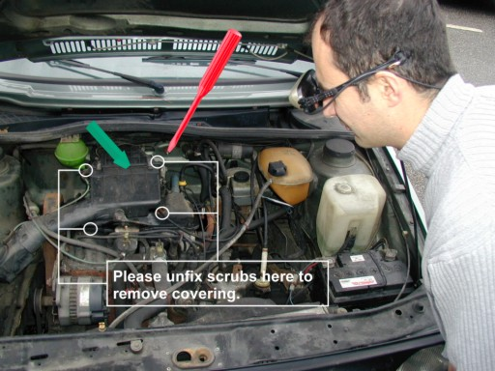
VR Examples (Cont’d)
Augmented VR

Slide 11
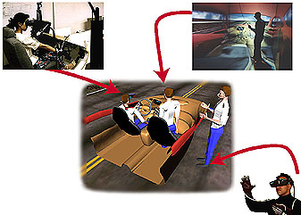
VR Examples (Cont’d)
Distributed VR

Slide 12
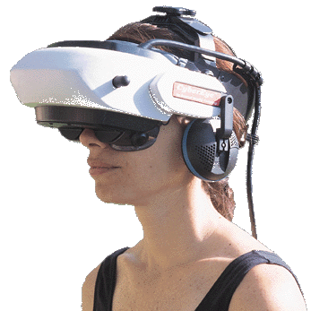
Technologies of VR--Hardware
Head-Mounted Display (HMD)
  A Helmet or a face mask providing the visual and auditory displays.
  Use LCD or CRT to display stereo images.
  May include built-in head-tracker and stereo headphones

Slide 13
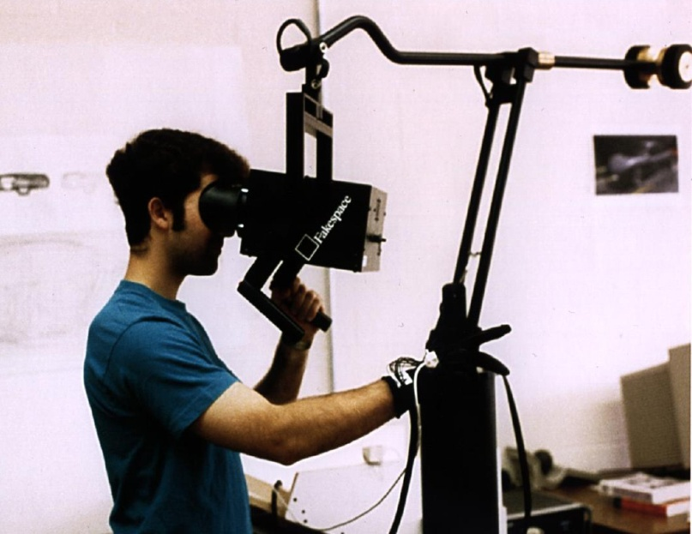
Technologies of VR--Hardware
Binocular Omni-Orientation Monitor (BOOM)
  Head-coupled stereoscopic display device.
  Uses CRT to provide high-resolution display.
  Convenient to use.
  Fast and accurate built-in tracking.

Slide 14
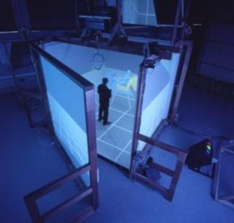
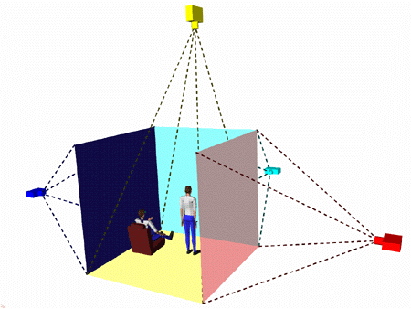
Technologies of VR--Hardware
Cave Automatic Virtual Environment (CAVE)
  Provides the illusion of immersion by projecting stereo images on the walls and floor of a room-sized cube.
  A head tracking system continuously adjust the stereo projection to the current position of the leading viewer.

Slide 15
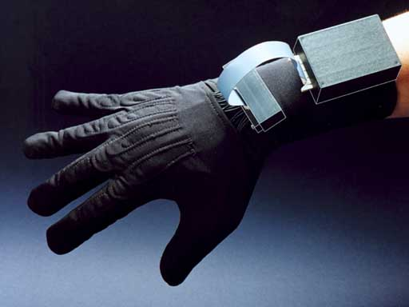
Technologies of VR--Hardware
Data Glove
  Outfitted with sensors on the fingers as well as an overall position/orientation tracking equipment.
  Enables natural interaction with virtual objects by hand gesture recognition.

Slide 16
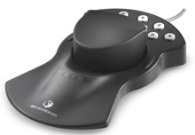
Technologies of VR--Hardware
Control Devices
  Control virtual objects in 3 dimensions.

Slide 17
Technologies of VR--Software
Toolkits
  Programming libraries.
  Provide function libraries (C & C++).
Authoring systems
  Complete programs with graphical interfaces for creating worlds without resorting to detailed programming.

Slide 18
Technologies of VR--Software
Software packages available in market
  Multiverse (Freeware)
  Virtual Reality Studio ($100)
  Sense8 World Tool Kit (WTK) (over $1000)
  Autodesk Cyberspace Development kit (over $1000)

Slide 19
Technologies of VR--Software
VRML(Virtual Reality Modeling Language)
  Standard language for interactive simulation within the World Wide Web.
  Allows to create "virtual worlds" networked via the Internet and hyperlinked with the World Wide Web.
  Aspects of virtual world display, interaction and internetworking can be specified using VRML without being dependent on special gear like HMD.
  VR models can be viewed by Netscape or IE with a browser plug-in.

Slide 20
Architecture of VR System
Input Processor, Simulation Processor, Rendering Processor and World Database.
visual, auditory, haptic, touch…
Position &
Orientation
Input
Processor
Rendering
Processor
Simulation
Processor
World Database

Slide 21
Components of VR System (Cont’d)
Input Processor
  Control the devices used to input information to the computer. The object is to get the coordinate data to the rest of the system with minimal lag time.
  Keyboard, mouse, 3D position trackers, a voice recognition system, etc.

Slide 22
Components of VR System (Cont’d)
Simulation Processor
  Core of a VR system.
  Takes the user inputs along with any tasks programmed into the world and determine the actions that will take place in the virtual world.

Slide 23
Components of VR System (Cont’d)
Rendering Processor
  Create the sensations that are output to the user.
  Separate rendering processes are used for visual, auditory, haptic and other sensory systems. Each renderer take a description of the world stat from the simulation process or derive it directly from the World Database for each time step.

Slide 24
Components of VR System (Cont’d)
World Database (World Description Files)
  Store the objects that inhabit the world, scripts that describe actions of those objects.

Slide 25
Applications
Entertainment
  More vivid
  Move exciting
  More attractive

Slide 26
Applications (Cont’d)
Medicine
  Practice performing surgery.
  Perform surgery on a remote patient.
  Teach new skills in a safe, controlled environment.

Slide 27
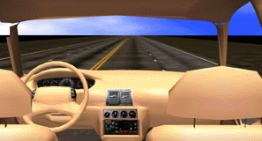
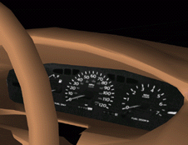
Applications (Cont’d)
Manufacturing
  Easy to modify
  Low cost
  High efficient

Slide 28
Applications (Cont’d)
Education & Training
  Driving simulators.
  Flight simulators.
  Ship simulators.
  Tank simulators.

Slide 29
Current problems & Future work
Cybersickness / simulator sickness
Low-fidelity
Expensive
Lack of integration between application packages
High-fidelity system
Cost-saving
Collaborative
High-level contact between participants in distributed VR

Slide 30
Summary
Visualization of complicated, large data is helpful for understanding and analysis.
VR offers us a new way to interact with computer.
VR enables us to experience the virtual world that is impossible in real world.
VR is changing our life, eventually VR will increasingly become a part of our life.

Slide 31
Reference
[1] What is Virtual Reality?, http://vr.isdale.com/WhatIsVR/frames/WhatIsVR4.1.html.
[2] Augumented and Mixed Reality, http://www.mic.atr.co.jp/~poup/research/ar/.
[3] Virtual Reality Applications, http://vresources.jump-gate.com/applications/applications.shtml.
[4] K.-P. Beier. Virtual Reality: A short Introduction. http://www-vrl.umich.edu/intro/
[5] Franchi,J. Vertual Reality: An Overview. ERIC Digest, June 1995

Slide 32
Comments & Questions?

