Slide 1
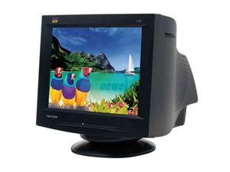
Color CRT Monitors

Slide 2
INDEX
INTRODUCTION
HISTORY
WORKING
MERITS
DEMERITS
COMPERSION
FUTURE SCOPE
ACKNOWLEDGEMENT
REFERENCES
ANY QUERY

Slide 3
INTRODUCTION
Color CRT monitor display picture by using combination of phosphors that emit different colored light.

Slide 4
HISTORY
One of the earlist electronic display is cathode ray tube ,which was made in 1992.
The first commercial color CRT was produced in 1954.
CRT were single popular display technology for half a century.

Slide 5
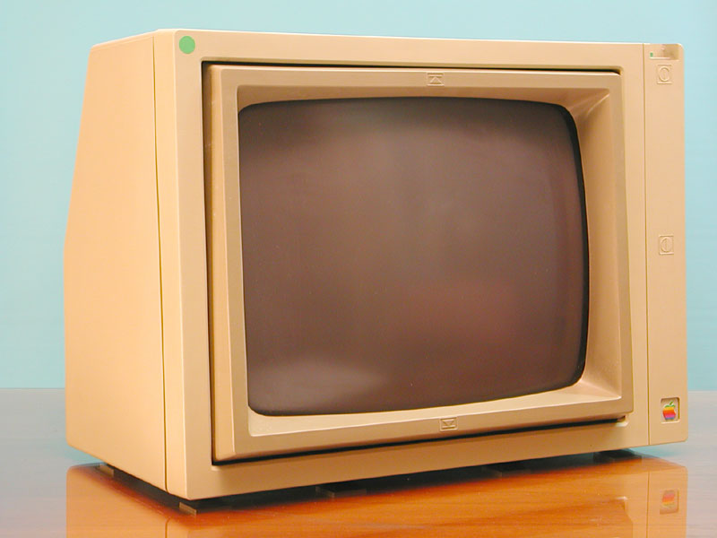
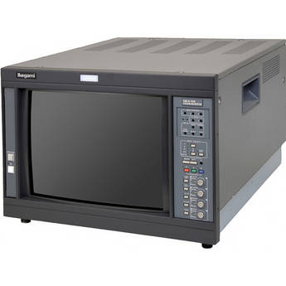
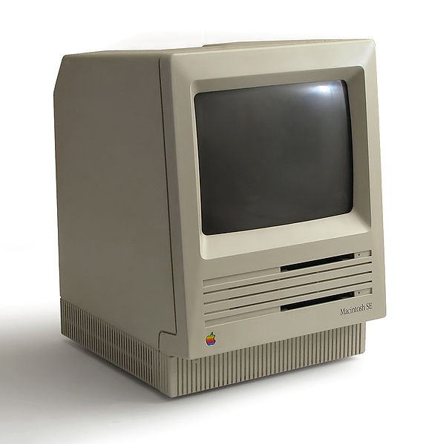
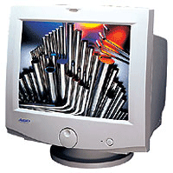

Slide 6
WORKING
BEAM PENETRATION :
The beam penetration method for displaying color pictures has been used with random scan monitors .Two layers of phosphor usually red and green are coated on to the inside of CRT .
The speed of the electrons and hence the screen color at any point is controlled by the acceleration voltage.

Slide 7
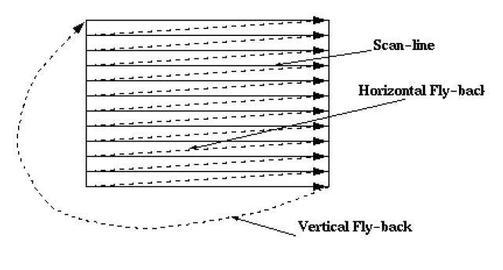

Slide 8
WORKING CONTINUE……..
SHADOW MASK
Shadow mask CRT has three phosphor color dots at each pixel position. This type of CRT has three electron gun . A shadow grid just behind the phosphor coted screen. Delta delta shadow mask method commonly used in color CRT system.
The 3 electron beams are denoted and focused as a group onto the shadow mask when the 3 beams pass through a hole in the shadow mask they activated a dot triangle which appears as a small spot on the screen.

Slide 9
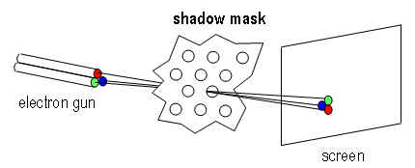

Slide 10
WORKING
CRT whether TV or monitor basically same.
It is a vacuum tube with a flat bottom.
It has an electron gun.
A cathode generates electrons due to heating filament.
The normally bounded electrons acquire heat to over come to the surface potential.
Actually the electron gun is design and collimating an.

Slide 11
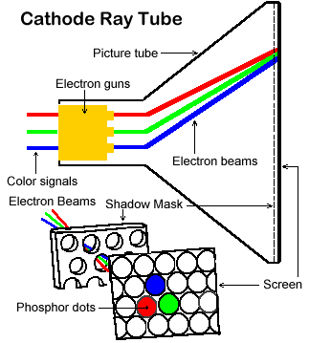
WORKING CONTINUE…….

Slide 12
WORKING CONTINUE………
Current carrying coils around the around the neck of the tube will deflect the beam side ways.
The deflecting beam is doing scan.
The picture comes in frame by frame start of the frame is synchronized with start of scan what is called frame sync pulse.
It producing picture by using two basic methods are
1.Beam Penetration Method
2 Shadow-Mask Method

Slide 13
MERITS
High Resolution
Black level and Contrast
Color and Gray scale Accuracy
Motion Artifacts
Cost

Slide 14
DEMERITS
Sharpness
Interference
Geometric Distortion
Brightness
Screen Shape
Emission
Physical

Slide 15
DIFFERENCES
 | CRT | LED | LCD | PLASAMA
COLOR SATURATION | Best | Good | Mediocre | Really Good
POWER DEMAND | Largest | Medium | Low | High
CANTRAST RATIO | best | mediocre | good | Really Good
SPEED | Good | Fast | Slow | High
EMISSIONS | Worst Emission | No Emission | No Emission | Bad Emission

Slide 16
ACKNOWLEDGEMENT
I would like to thank my sir Mr. Umesh Gupta Assistant Professor of CS Department to give this opportunity to give presentation and motivate me

Slide 17
REFERENCES
[1] (2016,24 ) “Color CRT Monitor” Available:
[https://www.google.co.in/#q=colour+crt+monitor]
[2] Donald D.Hearn ,M.Pauline Baker,2nd Edition,PEARSON,1997,pp 62-64.

Slide 18


ANY QUERY
?????............

Slide 19

TAHNK YOU

