Slide 1
Texture Mapping

Slide 2
Overview
Texture mapping
  Inverse and Forward Mapping
  Bilinear interpolation
  Perspective correction
Mipmapping
Other forms of mapping
  Environment
  Bump mapping

Slide 3
Texture Mapping
Why?
  Approximation for surface colouring
  Efficient packing of flat detail
Standard texture mapping modifies diffuse mapping
  Pasting a picture onto the polygon

Slide 4


Inverse Mapping
Each vertex is associated with a point on an image (u,v)

Slide 5
Forward Mapping
For points in the image, map onto the polygon
  much harder to implement correctly, and harder to model
Inverse mapping is much more commonly used
  Most 3D modelers output U,V co-ordinates for texture application

Slide 6
Quick and Dirty Solution
Yet more parameters in the ET!
Bilinear interpolation of u&v down scene edges, and across scan-lines
Works, but is very ugly
  Does not consider fore-shortening of image in depth

Slide 7


The Problem
z correct
z incorrect
Same problem exists with phong and gouraud shading, but it MUCH less noticeable

Slide 8
The Solution
Need to compensate for fore-shortening by interpolating over 1/z
Interpolate (u’,v’,q) where q=1/z
  At vertices we know (u₁,v₁,z₁), (u₂,v₂,z₂)
  Interpolate between (u_{1*}z₁,v_{1 *}z₁,1/z₁) and (u_{2*}z₂,v_{2 *}z₂,1/z₂) to get (u’,v’,q)
  Restore u,v, by dividing u’ and v’ by q

Slide 9
Sanity Check
At p0 (u’,v’,q) = (0,0.1,0.1)
At p1 (u’,v’,q) = (0,0,0.05)
On scanline 5 (u’,v’,q) = (0,0.05,0.075)
(u,v) = 0.6666
z = 1/0.075 = 13.33
p1=(15,15,20,0,1)
(x, y, z,u,v)
scanlines
Y=15
Y=10
Y=5
p0=(10,5,10,0,0)

Slide 10
Minor Issues
Now have two divides per pixel!
Some optimisations
  only do the divide at end of the spans and interpolate across spans
  or only do the divide every n pixels
Remaining problem
  we have not touched upon how to clip u,v values in 3D or 2D!

Slide 11
Major Issues
Picking your pixel!
image

Slide 12
Sampling
A pixel maps to a non-rectangular region
Usually only perform map on centre of pixel
Still have a problem of over-sampling (same texel maps to several pixels) or under-sampling the image (pixels only sparsely sample the texels)

Slide 13
Filtering
Nearest neighbour
Pick pixel with closest centre
Bilinear
Weighted average based on distance to pixel centre

Slide 14
Filtering
Bilinear filtering solves (partially) the oversampling problem since it provides smooth shading between pixels
scanline

Slide 15
Mip-Mapping
When undersampling we use mippmapping
Resample image at lower resolution
Create a “pyramid” of textures.
Interpolate texture between two adjacent layers

Slide 16
Texture Pyramid
...
1x1
32x32
64x64
128x128

Slide 17
Sampling
Choose two layers based on texel span
  Choice is made selecting the two levels where the dv and dv for dx and dy are closest to one
Interpolate between four pixels in higher layer and one in lower layer

Slide 18
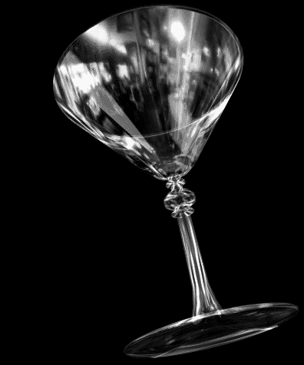
Environment Mapping
Don’t modulate diffuse colour modulate colour based on normal
Effectively creates a reflective object
The environment map is a surrounding texture

Slide 19
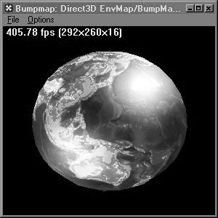
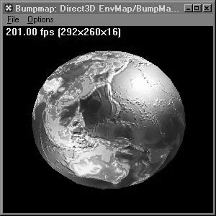
Bump Maps
Use a map to perturb the normal for specular lighting

