Slide 1
Sequence Control at
Statement Level

Slide 2
Forms of Statement Level Control
Composition
Alternation
Iteration
Explicit

Slide 3
Composition
int main(){
cout<<"Hello, World!\n“;
cout<<"I am a C++14 code running on your machine\n";
return 0;
}
Statements are executed in order they appear in code. By using statements in { } block.

Slide 4
Alteration
int main(){
int a = 0;
if(a)
cout << "I am zero";
else
cout << "I am not zero";
return 0;
}
Two sequences form alternatives so one sequence or the other sequence is executed but not both . Basically IF-ELSE statements.

Slide 5
Iteration
int main(){
for(int i = 0;i < 5;++i)
cout << "I am " << i << endl;
return 0;
}
A sequence of statements that are executed repeatedly.
(Basically LOOP statements).

Slide 6
Explicit
int main(){
label:
cout << "I am in under label”;
goto label;
return 0;
}
These are GOTO statements available only in few languages like C/C++, Java.

Slide 7
Proper Programs
A proper program is a flowchart with
1 entry point
1 exit point
There is a path from entry point to any point to exit point.

Slide 8
Prime Programs
A prime program is a proper program which has no embedded proper subprogram of greater than 1 node. (i.e., cannot cut 2 arcs to extract a prime subprogram within it).

Slide 9
Composite Programs
A composite program is a proper program that is not prime.

Slide 10
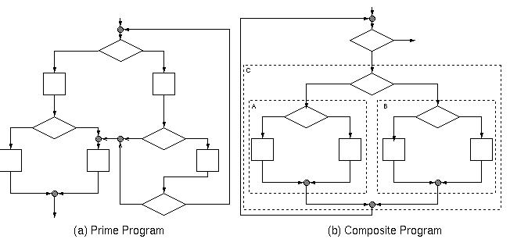

Slide 11
Happy
Programmers Day

