Slide 1
LIGHT EMITTING DIODE

Slide 2
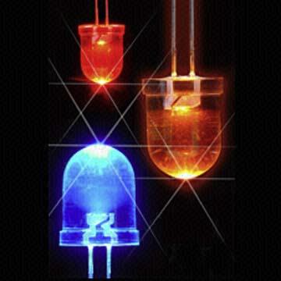
What is LED?
Semiconductors bring quality
to light!
FIG. 1
LED are semiconductor p-n junctions that under forward bias conditions can emit radiation by electroluminescence in the UV, visible or infrared regions of the electromagnetic spectrum.

Slide 3

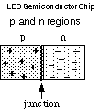
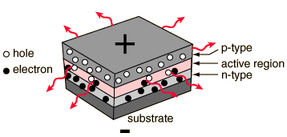
FIG 2
FIG. 3
Notes:
Ljhbluyuygon;I

Slide 4
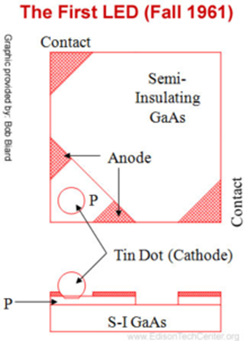
HISTORY OF L.E.D.
        In 1907
H.J. ROUND
In 1927
OLEG LOSEY
In 1962
NICK HOLONYAK
The first commercial LEDs were commonly used as replacements for incandescent and neon indicator lamps, and in seven-segment displays.
FIG.1

Slide 5
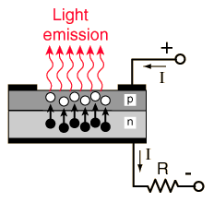
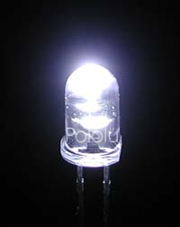
How L.E.D work?
P-n junction
Electrical Contacts
A typical LED needs a p-n junction
There are a lot of electrons and holes at the junction due to excitations
Electrons from n need to be injected to p to promote recombination
FIG. 1.1
Recombination produces light!!
Junction is biased to produce even more e-h and to inject electrons from n to p for recombination to happen
FIG. 1.2

Slide 6
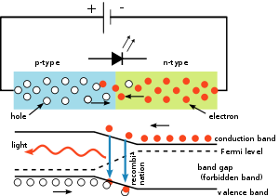
PROCESS OF RECOMBINATION
E
Electron (excited by the biased forward voltage) is in the conduction band
k
Hole is in valance band
FIG 1.3
FIG 1.4

Slide 7
COMPARISON BETWEEN L.E.D. AND L.C.D.
LED LCD (high bright)
Reliability 20,000 hours typical 50,000 hours typical
Wide Temperature Good Good
Sunlight Readability Moderate Good
Pixel pitch (pixels / inch) 0.20” (5) typical 0.011” (85) – 15” LCD
Number of Colours 1 Colour – Red typical 16 Million Colours
Graphic Display Capability None Full Colour Graphic
Cost Low Moderate

Slide 8
APPLICATIONS OF L.E.D.
Sensor Applications
Mobile Applications
Sign Applications
Automative Uses
LED Signals
Illuminations
Indicators

Slide 9

Sensor Applications
Medical Instrumentation
Bar Code Readers
Color & Money Sensors
Encoders
Optical Switches
Fiber Optic Communication
FIG. 1.1

Slide 10

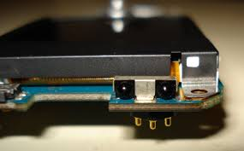

Mobile Applications
FIG. 1.2.2
Mobile Phone
PDA's
Digital Cameras
Lap Tops
General Backlighting
FIG, 1.2.3
FIG. 1.2.1

Slide 11
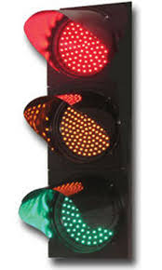
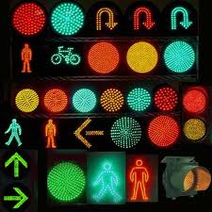
Sign Applications
Full Color Video
Monochrome Message Boards
Traffic lighting
Transportation - Passenger Information
FIG. 1.3.1
FIG 1.3.2

Slide 12
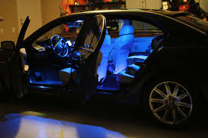
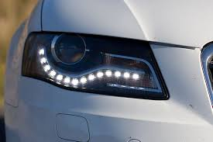
Automative Applications
Interior Lighting - Instrument Panels & Switches, Courtesy Lighting
Exterior Lighting - CHMSL, Rear Stop/Turn/Tail
Truck/Bus Lighting - Retrofits, New Turn/Tail/Marker Lights
FIG. 1.4.1
FIG. 1.4.2

Slide 13
Signal Appications
Traffic
Rail
Aviation
Tower Lights
Runway Lights
Emergency/Police Vehicle Lighting
LEDs offer enormous benefits over traditional incandescent lamps
Including
Energy savings (up to 85% less power than incandescent)
Reduction in maintenance costs
Increased visibility in daylight and adverse weather conditions

Slide 14
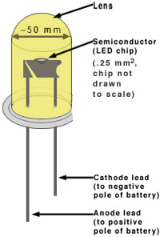
Getting to know LED….
Advantages of Light Emitting Diodes (LEDs)
Longevity:
The light emitting element in a diode is a small conductor chip rather than a filament which greatly extends the diode’s life in comparison to an incandescent bulb (10 000 hours life time compared to ~1000 hours for incandescence light bulb)
Efficiency:
Diodes emit almost no heat and run at very low amperes.
Greater Light Intensity:
Since each diode emits its own light
Cost:
Not too bad
Robustness:
Solid state component, not as fragile as incandescence light bulb
FIG. 1.2.3
FIG. 1.2
FIG. 1.2.1

Slide 15
ACKNOWLEDGMENT
I would like to thanks Mr. UMESH GUPTA for providing me with such a knowledgeable topic.
I wish to acknowledge the help provided by my colleagues.
Last but not the least I would like to thanks everyone sitting here and to be the part of this presentation.

Slide 16
BIBLIOGRAPHY
VARIOUS WEBSITES WRITTEN ABOUT L.E.D
en.wikipedia.org/wiki/Light-emitting_diode
www.howstuffworks.com/led.htm
hyperphysics.phy-astr.gsu.edu/hbase/electronic/leds.htm
www.ele.uri.edu/courses/ele432/spring08/LEDs.pdf

Slide 17
CONCLUSION
Light emitting diodes was the ultimate discovery as it is economical easy to use and has a longer life than any ordinary artificial light.
LED can emit light of longer wavelength .
All in whole we can say that light emitting diodes can be added to day to day necessity.

Slide 18
Query Time
If any body has any question related to this L.E.D. topic I would be happy and I will give my best to answer them.

Slide 19


