Slide 1
Anisotropic Diffusion

Slide 2
About the upcoming class:
In this class, we will introduce the basics of Anisotropic diffusion, and its usage in scale-space actions and edge detection in graphic images.
The focus of the lecture will be gaining intuition about the Anisotropic Diffusion work process. Less focus will be dedicated to Mathematical analysis of procedures. This author thereby promises, to make his best effort and keep you interested throughout the class.
Any attendant may ask any question at any time during class.

Slide 3
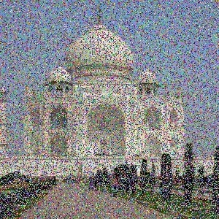
Introduction
What is the main drawback of this picture ? ➔
Image noise
In what ways does it bother us ?
visually… as humans
lost detail
renders the image unfit for most of our desired image manipulation filters

Slide 4
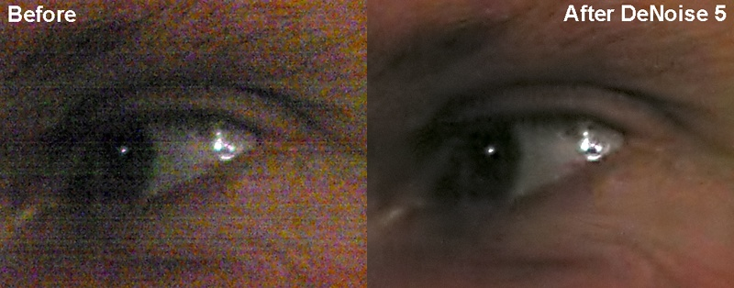
So, we are looking for an efficient method of noise removal, that is able to clarify the image.

Slide 5
Methods of noise removal were known a long time before the Anisotropic Diffusion case was first claimed (1990)
Most of the methods are typically forms of applying a blur filter to the image, as Blurring it hopefully results in a smooth, noise-less product.
Such a product, with low noise levels, is a much better starting point for any image related algorithm…

Slide 6
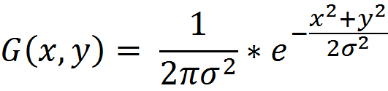
Classic smoothing methods:
Based on convolving a Gaussian kernel with each and every pixel. A typical kernel would be of size NxN.
The single pixel’s brightness value is determined by its own original value, as well as the values of its neighbor pixels.
an appropriate definition of the transformation would be:
I (x,y) = I₀ (x,y) * G(x,y,t)

Slide 7
Making a gaussian kernel of size NxN:
Set the center of the kernel to be x=0, y=0 => (0,0)
Using the equation, set the values on every square of the kernel:
Squares closer to the center (such as (1,2)) would get higher values than squares which are close to the kernel’s border.
Note:
t = theoretically is sigma^2, tough – in a C.s implementation it is the size of the gaussian (3x3,7x7 etc…)

Slide 8
Gaussian 5x5 (without normalization)
2 | 4 | 5 | 4 | 2
4 | 9 | 12 | 9 | 4
5 | 12 | 15 | 12 | 5
4 | 9 | 12 | 9 | 4
2 | 4 | 5 | 4 | 2

Slide 9
Taking a gaussian kernel of size NxN:
Set the center of the kernel to be x=0, y=0 => (0,0)
Using the equation, set the values on every square of the kernel:
Squares closer to the center (such as (1,2)) would get higher values than squares which are close to the kernel’s border.
The parameter t stands for the variance of the gaussian:
when t=0 => I(x,y) = I₀(x,y) (just the ID transform…)
As t grows, the brightness of a pixel in the resulting image considers more and more of its neighboring values.

Slide 10
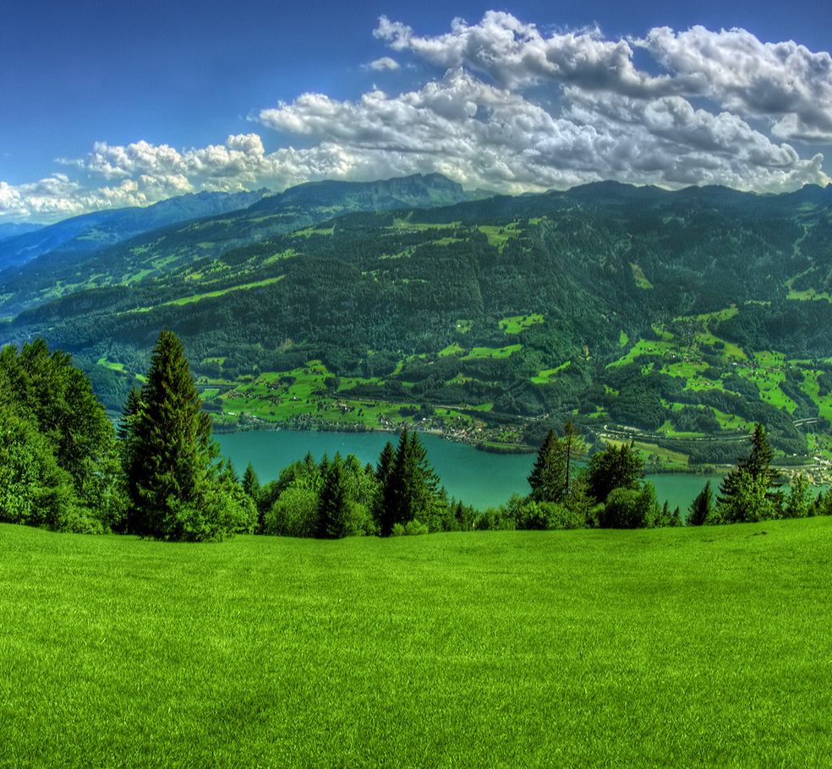

Slide 11
In this next example, notice how the blurring makes the grass color almost completely homogeneous… which in our case is considered a desired effect.
This is because the smoothing operation is vary useful in highly homogeneous regions, since it scales-down the complexity of the region to a simple “blub” of very few discrete brightness levels.
Using a few iterations of classic Gaussian Blurring, with kernel size of 7x7, 9x9 and 13x13, gives the following product image:

Slide 12


Slide 13
While being a popular tool, Gaussian pass has its downsides:
Loss of fine detail
Smoothing across boundaries
The first could be expected, as it is the direct trade-off of smoothing …
The second is problematic – with no clear boundaries, image segmentation proves to be difficult.
Here are some examples:

Slide 14
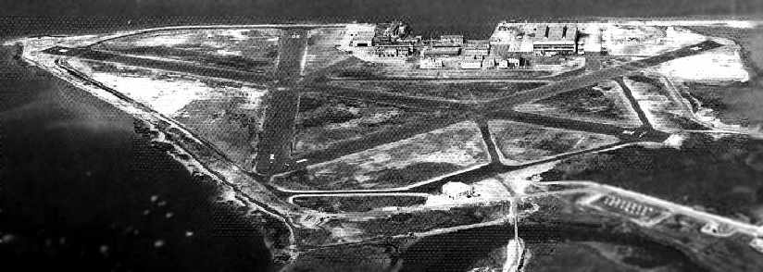
This ww2 photo is given here in its original form.
From a human eye point of view – it has a good enough quality.
Pay attention : some surfaces, like the runway’s asphalt or the roofs of the buildings, do not have a smooth texture…
(pacific us navy airbase, ww2)

Slide 15
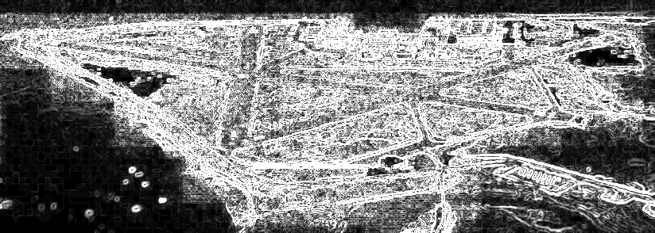
Now, pass the airbase photo through an edge detecting filter (sobel).
Result:
along with the “correct” edges, this product photo contains many false edges. This is not a good enough edge-marking product.

Slide 16
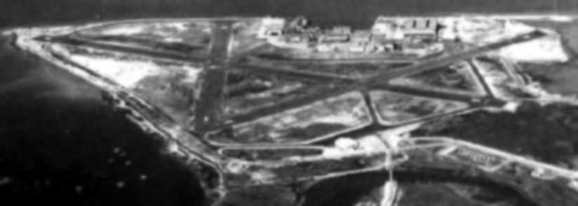
If we smooth the image, we can expect a lot less noise…
Smoothing the original with Gaussian 5x5…

Slide 17
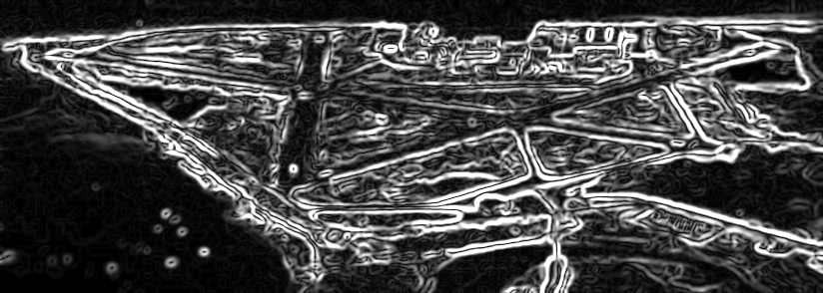
Running edge detection…
Many of the false edges were smoothed.
Unfortunately, so were the true edges.

Slide 18
Using this linear smoothing, gives especially poor results in more coarse images
(a.k.a low resolution images), as Blurring already makes an image a lot more coarse.
This is because meaningful edges in a coarse image would be smudged so much, that it is hard to determine where the real meaningful edge is originally located.

Slide 19
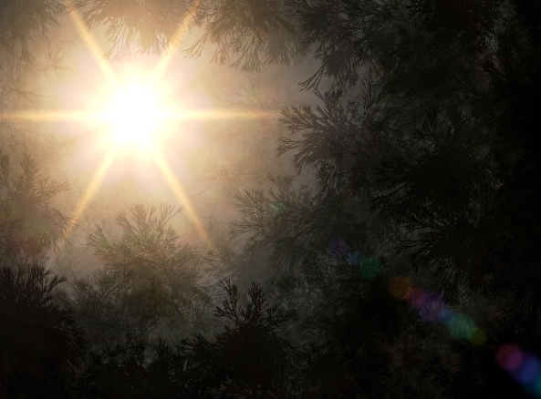
Diffusion
Diffusion describes the spread of particles through random motion from regions of higher concentration to regions of lower concentration.
(wiki)

Slide 20


Isotropic:
that is not dependent of direction.
Anisotropic:
depends on the direction applied

Slide 21



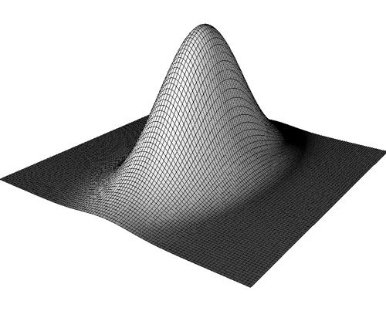

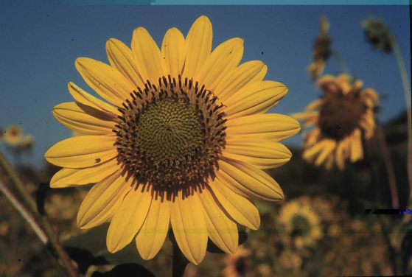
Heat spread
Do you get the intuition ?

Slide 22
Anisotropic approach
Wanted:
A form of smoothing specifically edges, with out loosing significance.
If found:
Then it could be combined with the non-linear smoothing idea, to produce an “all around” smoothing filter.
Remember – main drawback of the non-linear approach we saw earlier, was lack of intra-edge smoothing.
Ideas ?

Slide 23
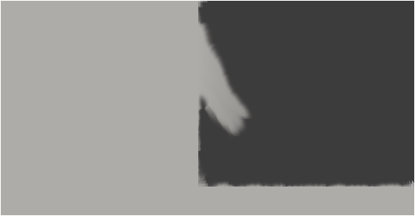
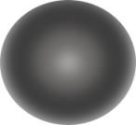
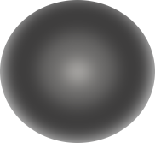
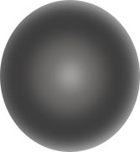
Use varying smoothing kernels !

Slide 24


The desired “direction” of the dynamic kernel is effected by the local gradient’s direction.
It is perpendicular to it…
If gradient is (a,b),
then a perpendicular vector to it,
can be (a, -b)
A dynamic kernel is contracted along the direction of the normal, ending in an elipticall kernel.

