Slide 1
Animation
Articulated Figures & Deformation

Slide 2
Animating Articulated Structures
Articulated structure
  Figure that consists of a series of rigid links connected at joints.
  Joints may be:
    Revolute (or rotary): only angles can vary
    Prismatic: sliding joint where length of link can vary
Kinematics
  Specification or study of motion independent of the underlying forces that produce the motion. It includes all geometrical and time related properties of the motion
Degrees of freedom (DOF)
  Number of independent variables necessary to specify the state of the structure

Slide 3
Animating Articulated Structures
State vector
  Vector of all possible configurations of an articulated structure.
  A set of independent parameters defining the positions and orientations, and rotations of all joints constituting the figure forms a basis of the state space.
  The dimension of the state space = DOF of structure
End effector
  Free end of the chain of links

Slide 4
Forward vs. Inverse Kinematics
Forward Kinematics:
The motion of all joints is specified explicitly by the
animator. The motion of the end effector is the
accumulation of all motions that lead to the end effector.
Inverse Kinematics:
The animator defines the position of end effectors only.
Inverse kinematics solves for the position and the orientation
of all joints in the link hierarchy that lead to the end effector.

Slide 5
A Simple 2-Link Articulated Structure
Forward:
Inverse:

Slide 6
A Simple 2-Link Articulated Structure:
Two Solutions

Slide 7
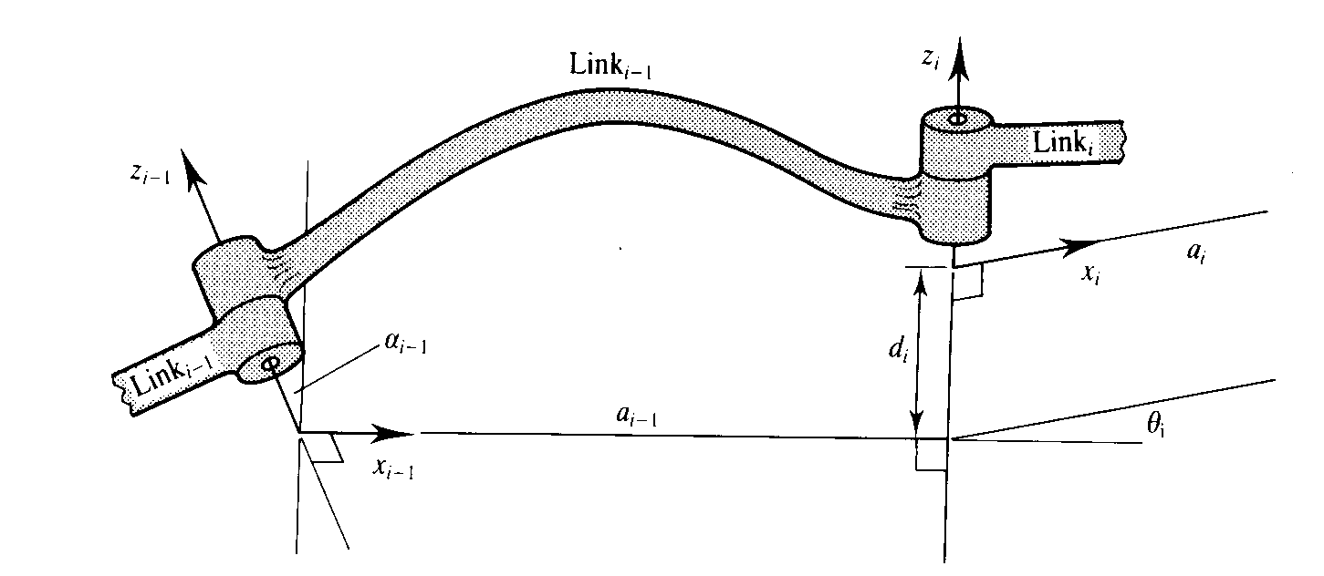
Representing Articulated Figures:
Denavit-Hartenberg (DH) Notation

Slide 8
Representing Articulated Figures:
Denavit-Hartenberg (DH) Notation

Slide 9
Representing Articulated Figures:
Denavit-Hartenberg (DH) Notation

Slide 10
Representing Articulated Figures:
Denavit-Hartenberg (DH) Notation
All frame-to-frame transformations can be concatenated to
form a single transformation that links frame 0 to frame N:

Slide 11
The Jacobian

Slide 12
The Jacobian:
Why is it Useful for Inverse Kinematics?
The inverse kinematics problem is stated:
For complex articulated figures, this is too complex to solve
for θ analytically. The problem can be solved incrementally by
localizing about the current state vector and inverting the Jacobian
to give:

Slide 13
The Jacobian:
Why is it Useful for Inverse Kinematics?

Slide 14
The Jacobian:
How do you Construct it?

Slide 15
The Jacobian:
How do you Construct it?

Slide 16
Application of Inverse Kinematics to a Skeleton
Root node
Base node
Open node
End node

Slide 17
Simple Legged Animation
Using Forward Kinematics
Hip
Upper leg (hip rotate)
Hip rotate
Upper
Leg
Knee
Lower leg (knee rotate)
Lower Leg
Hip rotate + knee rotate
Ankle
Foot
Foot (ankle rotate)

Slide 18
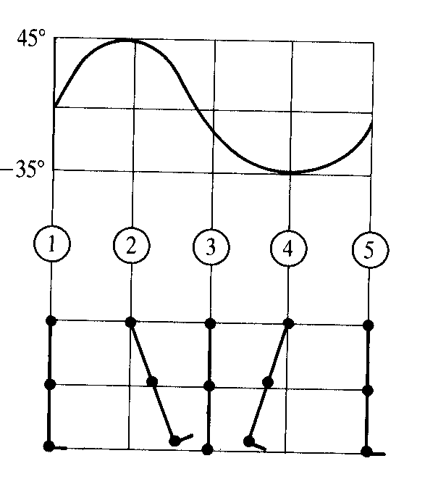
Simple Legged Animation
Hip Rotation Script

Slide 19
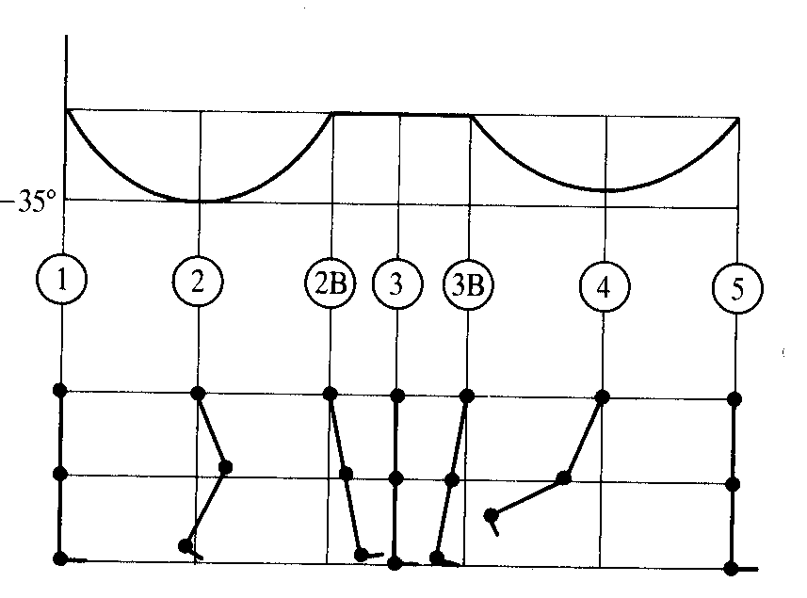
Simple Legged Animation
Knee Rotation Script

Slide 20
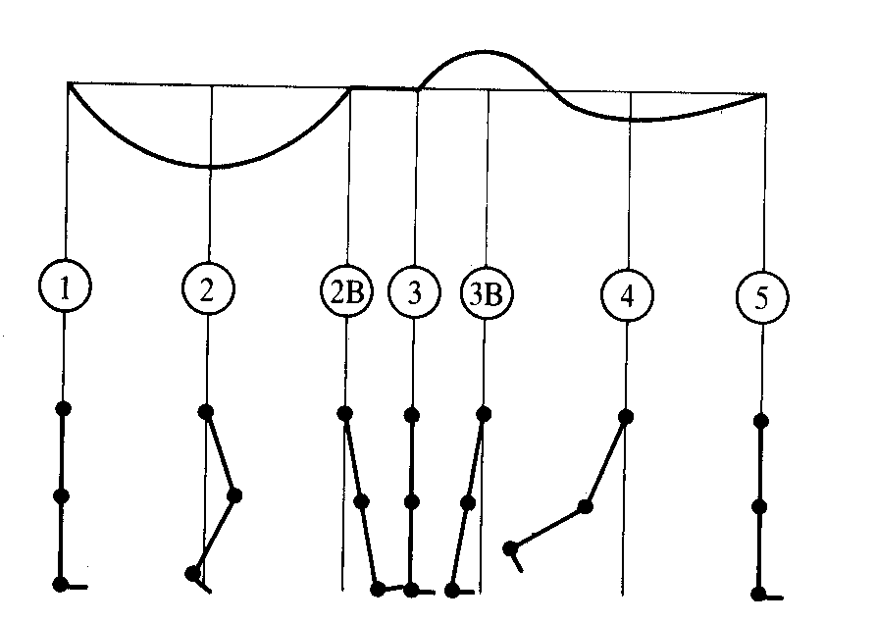
Simple Legged Animation
Ankle Rotation Script

Slide 21
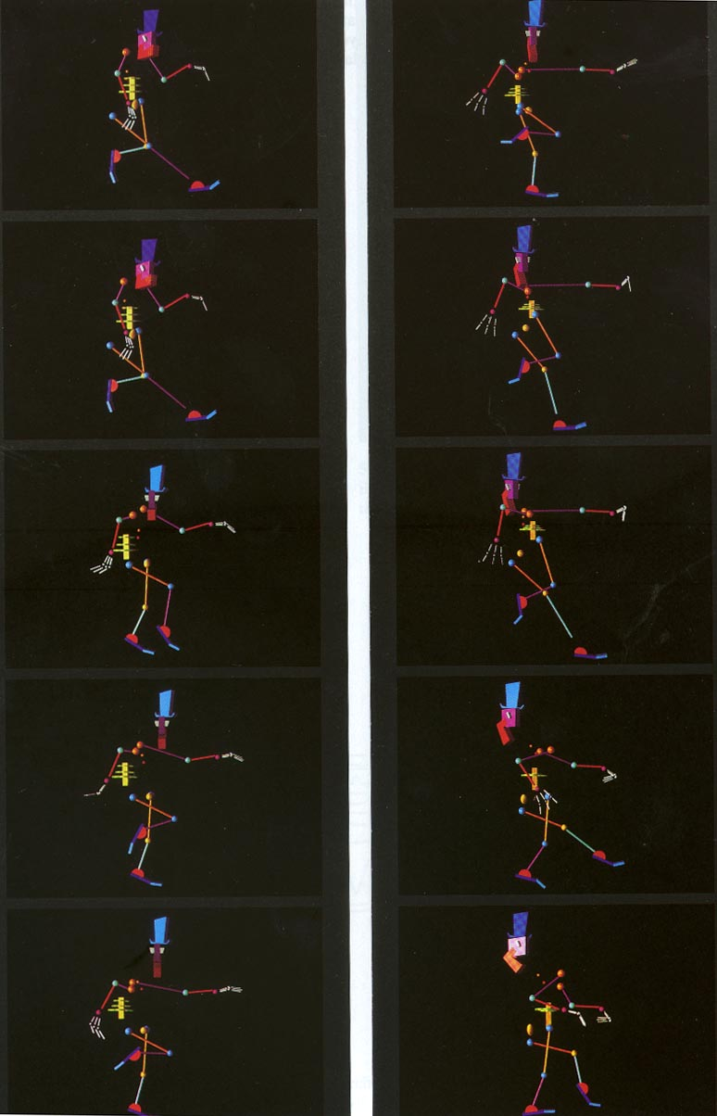
Simple Legged Animation
Resulting Animation

Slide 22
Soft Object Animation
The Basic Approaches
Deforming the polygonal representation
  Move the vertices defining the polygons as a function of time
  Connectivity among vertices must be taken into account
  Magnitude of deformation must be relatively small (or “simple”) with respect to vertex spacing
  Can cause polygon “aliasing” problems
    Most noticeable when planar or near planar regions, represented with sparse vertices, are deformed
Deforming the parametric representation
  Accomplished by deforming the control points
  Object still “well defined”

Slide 23
Nonlinear Global Deformation
Barr 1984
Barr’s notation:
Deformed vertex
Undeformed vertex
Taper along z axis:
Axial twisting:

Slide 24
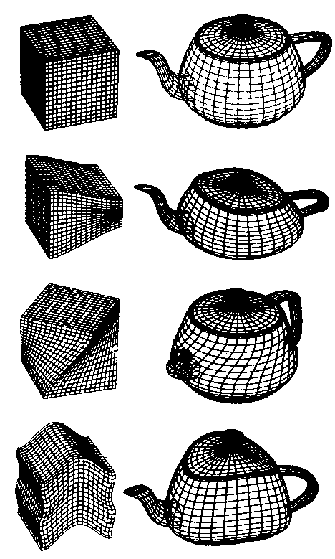
Nonlinear Global Deformation
An Example
Undeformed
Taper
Twist
Bend

Slide 25
Free Form Deformation
(Sederburg 1986)
A tricubic Bezier hyperpatch is defined:
An FFD block is a rectangular lattice of l x m x n Bezier hyperpatches,
consisting of an array of control points.
U
S
T

Slide 26
Free Form Deformation
The Algorithm
1. Determine the positions of the vertices in lattice space.
2. Deform the FFD block. This is accomplished by moving the
control points. The control points are initially located at:
3. Determine the deformed position of the vertices
- Given the lattice space coordinates of the vertices, find the
relevant hyperpatch
- convert (s,t,u) to the local parameter coordinate of the hyperpatch,
(u,v,w)
- Evaluate the position using:

Slide 27
Animating the Deformation:
Factor Curves
Extension of the concept of weighted transformation introduced by Barr
Animator breaks down the problem of animating a deformation into two components:
  A set of transformations that can accomplish the range of deformation required along with a parameterization of these transformations
  A set of factor curves in both space and time that modify the parameters of the deforming transformation according to where and when they are applied

Slide 28
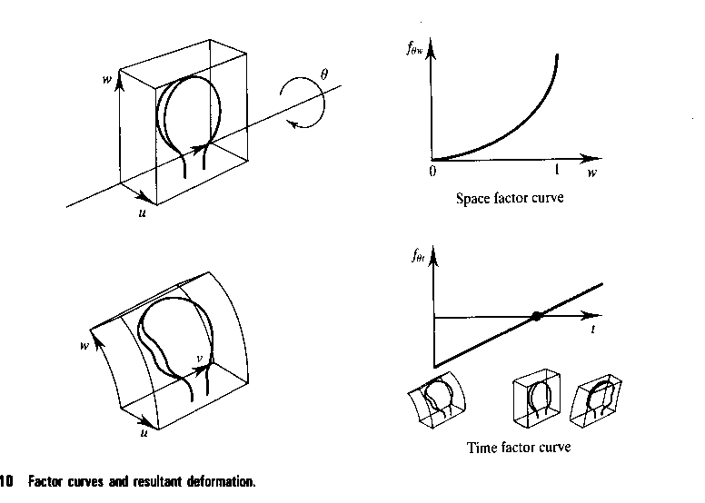
Factor Curves:
An Example

Slide 29
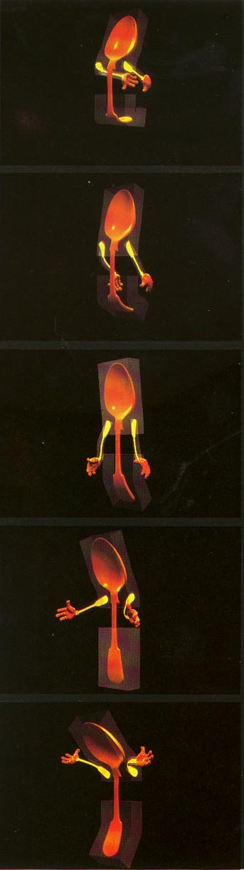
Factor Curves:
An Example: the Animated Spoon

