Slide 1


LIQUID CRYSTAL DISPLAY

Slide 2
TIPS TO BE COVERED
HISTORY
INTRODUCTION
WORKING PRINCIPLE
TYPES
MERITS
DEMERITS
CONCLUSION
COMPARISION
APPLICATION
BIBLOGRAPHY

Slide 3
ACKNOWLEDGEMENT
I wish to express my sincere thanks and deep
sense of gratitude to all my esteemed teachers, family and friends for her helpful suggestions throughout the life.

Slide 4
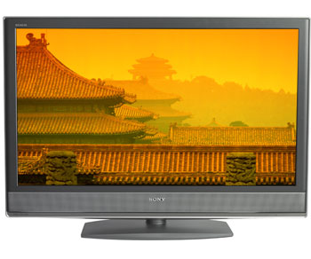
EVOLUTION
LCDs are a type of light modulating display
device.
LCD technology does not emit light in visual form.
It modifies the transmission of light to represent
images.
On the other hand Plasma displays, CRT and
OLED devices are all light emitting display
devices.
LCDs are rapidly becoming the most popular
display device available.

Slide 5
HISTORY AND DEVLOPEMENT
  1970’s
    First commercial LCDs came into existence. The technology
    was first used in the quartz watch and in early calculator
    displays.
  1990’s
    Early use of colour LCDs for digital cameras and computer
    monitors.
  2000’s
    Technological improvements led to larger LCDs suitable for
    home theatre use.
    “Full HD 1080p displays produced
    Currently the largest LCD panel is 108”

Slide 6
Introduction of LCD
WHAT IS LCD????
A liquid crystal display is a thin flat panel use for electronically
displaying information such as text, Images and moving pictures.
It uses include computer monitors , televisions, instrument panels
and calculators etc.

Slide 7
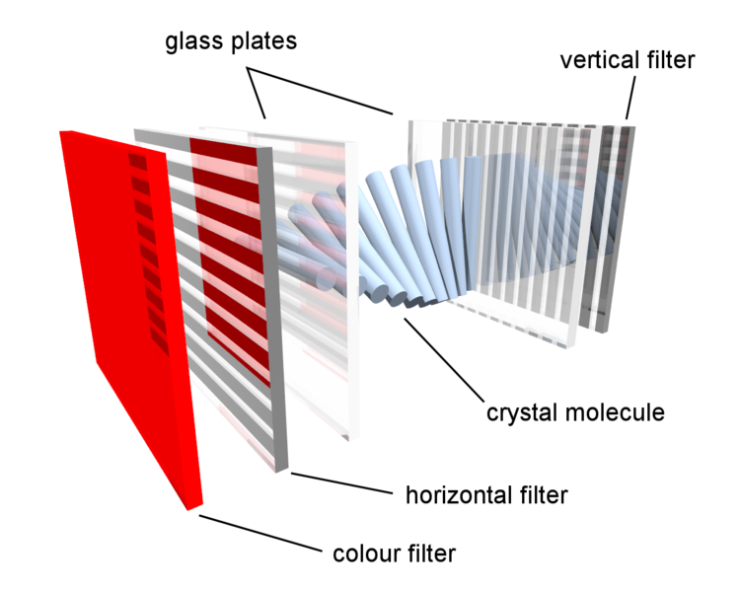
WORKING PRINCIPLE OF LCD
  The panel consists of a number of layers:
  Liquid crystal layer
  2 transparent conductors
  2 perpendicular polarizing
  filters.
  Colour filter
  In their natural state the liquid crystal align themselves in order.
  The molecule works on the concept of polarization.

Slide 8
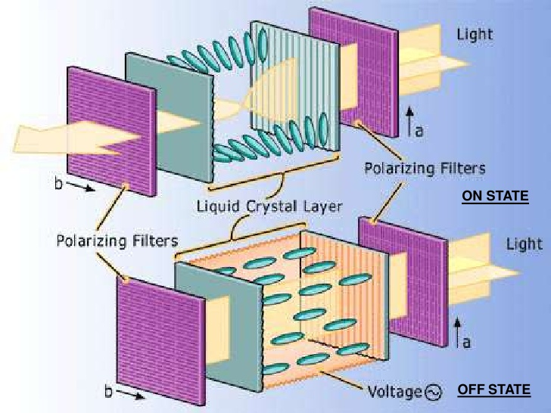
WORKING PRINCIPLE OF LCD

Slide 9
Types of LCDs
  Passive
    Each pixel must retain its state without a
    steady electric charge.
    Scanned one pixel at a time
    Poor contrast and very slow response time.
  Active
    Electric charged is stored between refreshes
    scanned one row at a time.

Slide 10
ADVANTAGES
BRIGHTNESS
EMISSION
GEOMETRIC DISTORTION
POWER CONSUMPTION
PHYSICAL ASPECTS
SCREEN SHAPE
SHARPNESS

Slide 11
DISADVANTAGES
ASPECT RATIO
RESOLUTION
COST
MOTION ARTIFACT

Slide 12

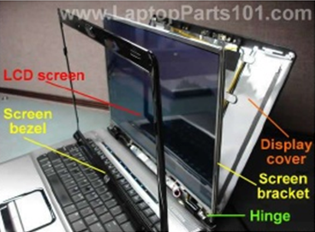
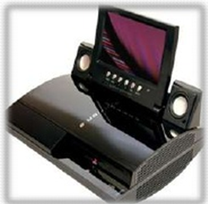
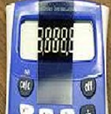

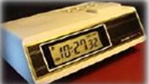
APPLICATIONS OF LCD

Slide 13
GREAT COMPETATOR :LCD
LCD TV advantage over Plasma TV:
      Brighter than plasma
      Screen surface is less reflective
      Perform well at high altitudes
      Lighter in weight
      Long display life
      Cooler running temperature

Slide 14
CONCLUSION
A liquid crystal display (LCD) is a type
of flat panel display.
They are called “liquid crystal” that
these compound have a crystalline
arrangement of molecules.

Slide 15

QUESTIONS..???

Slide 16
REFRENCE
P. Engardio, E. Woyke, M. Ihlwan, K. Hall. 2007. Flat Panels, Thin Margins. Business Week. Issue 4023. pg. 50-51.
Jeffrey A. Hart. Technology, Television and Competition. Cambridge University Press, 2004.
D.J. Channim, A. Sussman. Liquid-Crystal Displays, LCD. Topics in Applied Physics Volume 40: Display Devices. Ed. J. I. Pankove. New York, 1980.
Liquid Crystal Display http://en.wikipedia.org/wiki/Liquid_crystal_display

Slide 17
THANKYOU…….

